Slide 1

DEPARTMENT OF ELECTRICAL AND ELECTRONICS ENGINEERING
MINOR PROJECT
24EEEW301
(2024-2025)
"Simulation-Guided Design of Battery Packs for Real-World Hardware Systems“
Guide: Prof. Tushar Birje
SRN | Student Name
02FE21BEE009 | Ashmith Shet
02FE22BEE022 | Pooja Patil
02FE22BEE029 | Sakshi Kadlibuddi
02FE22BEE042 | Soujanya Bisalapur
02FE22BEE411 | Parvez Bagali
Department of Electrical and Electronics

Slide 2
Introduction:
In the era of increasing demand for sustainable energy solutions, battery storage systems play a crucial role in a wide range of applications, from electric vehicles to renewable energy storage. Modeling and simulating these battery packs accurately is vital for understanding their performance, efficiency, and lifecycle. MATLAB Simulink provides a robust platform to design and simulate battery systems in a virtual environment, offering insights into thermal characteristics, voltage behavior, and state of charge (SOC) variations. This project aims to develop and analyze a battery pack model using Simulink, emphasizing system-level behavior and control strategies.

Slide 3
Problem Statement:
This project aims to model a battery pack using Simulink to study its behavior during charging, discharging, and under different conditions. A simple cell model will be created and combined to form a battery pack, helping to improve battery performance and design.

Slide 4
Objectives:
1.To design and simulate a battery pack in Simulink.
2.To study the behavior of individual cells and their series/parallel configuration.
3.To analyze the voltage, current, and SOC characteristics during charging/discharging.
4.To integrate basic battery management logic to ensure performance and safety.
5.To evaluate efficiency and losses within the system.

Slide 5
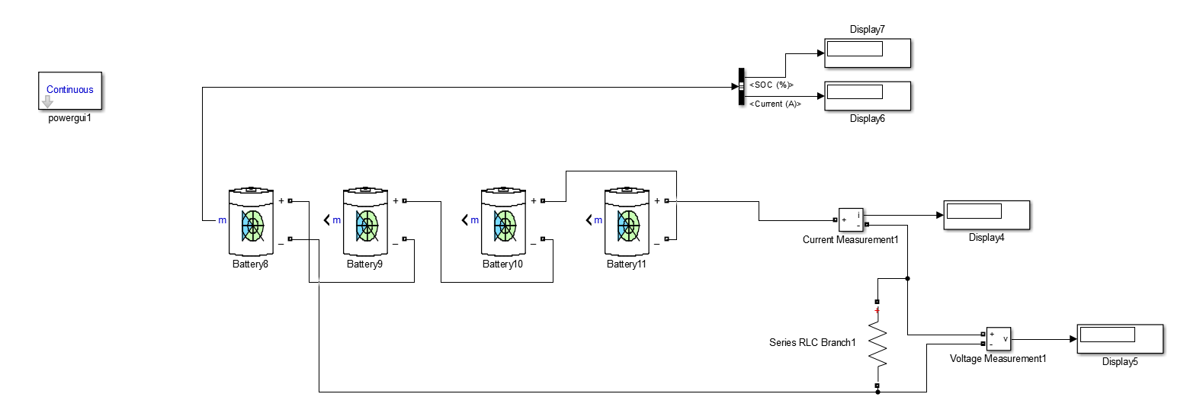
Simulation of Battery Pack:

Slide 6
Methodology:
Design Hardware – Use Raspberry Pi Pico with sensors, LCD, buzzer, and relays.
Set Parameters – Choose battery type, number of cells, and starting charge.
Create Model – Build the battery in Simulink with charging, discharging, and safety features.
Connect Cells – Arrange cells in series/parallel to form a battery pack.
Run Hardware – Test how the battery behaves under different loads and temperatures.
Analyze & Improve – Check results and adjust settings to improve efficiency and safety.
Real-Time Control – Monitor battery status and control charging with alerts.
Compare – Match hardware results with simulation to confirm accuracy.

Slide 7
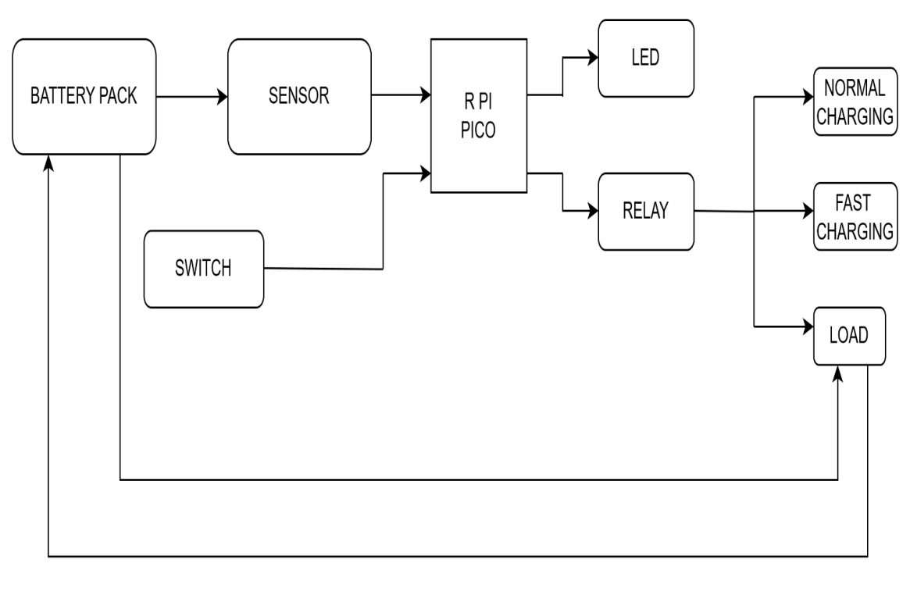
Functional block diagram

Slide 8
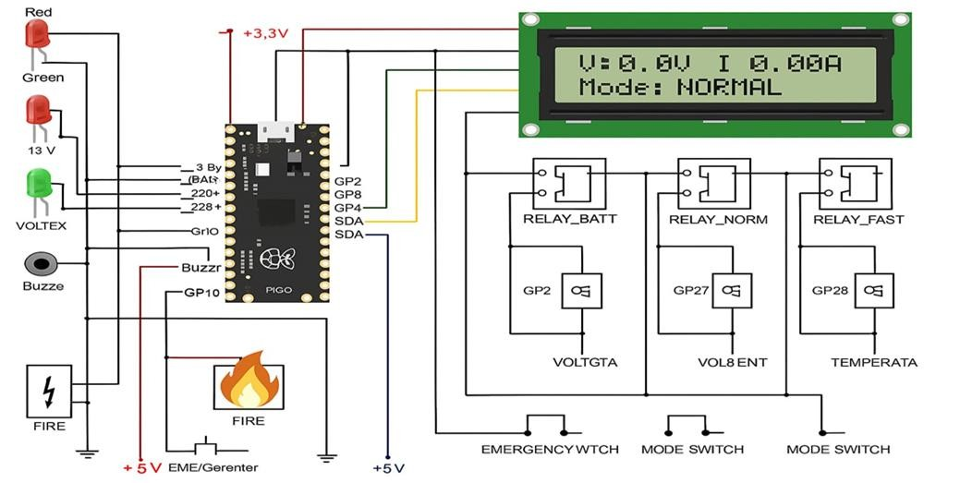
Design alternative

Slide 9
Optimisation of the developed solution:
Use accurate equivalent circuit model .
Add SoC and SoH estimation blocks.
Include thermal modeling.
Optimize BMS logic with filters
Simulate realistic load/drive cycles.
Use model simplification for faster runs.
Apply parameter tuning.

Slide 10
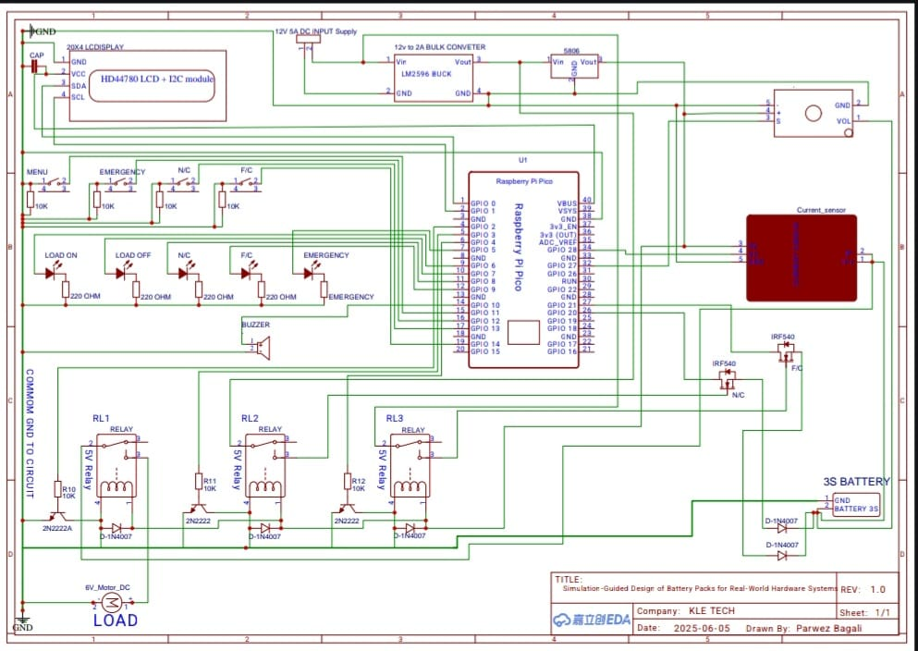
Circuit diagram

Slide 11
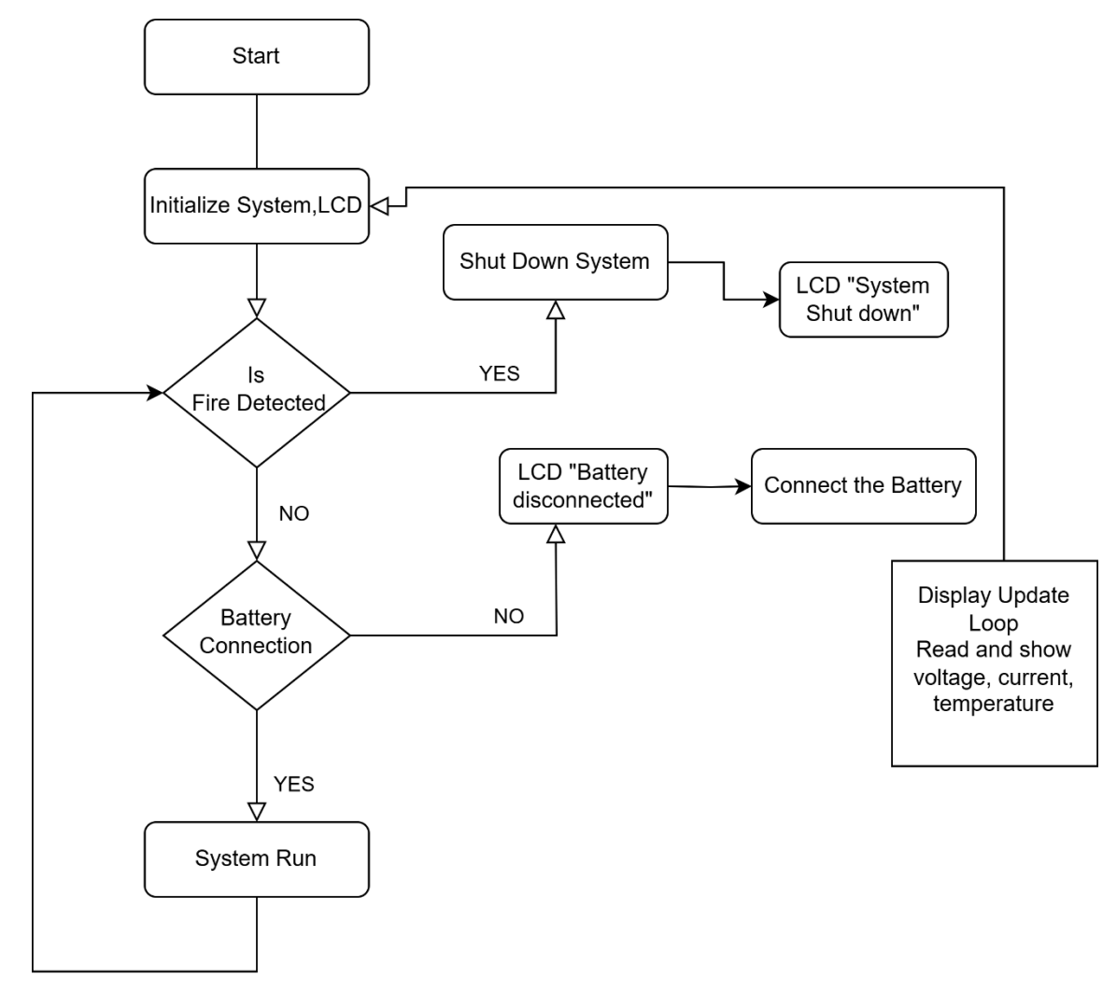
Flow chart

Slide 12
Analysis of the result:
1.Charging:
Voltage and SOC increased steadily.
Displayed typical Constant Current–Constant Voltage (CC-CV) behavior.
2.Discharging:
Voltage dropped gradually as SOC decreased.
Delivered energy matched expected output.
3.Under Load Variations:
Higher loads caused faster voltage drops and reduced efficiency.
4.Under Temperature Variations:
Low temperatures increased resistance and reduced performance.
High temperatures risked overheating.
5.Conclusion:
The model effectively simulates real battery behavior and supports design optimization.

Slide 13
Hardware model connection
Microcontroller: Raspberry Pi Pico (PICO)
Powered with +3.3V and GND from the top power rails.
I/O Pin Connections
GP2:Connected to RELAY_BATT control circuit and VOLTGTA relay coil.
GP4:Connected to the LCD (used for I2C – likely SDA).
GP10:Controls the Buzzer.
GP27:Connected to RELAY_NORM and VOL8ENT relay coil.
GP28:Connected to RELAY_FAST and TEMPERATA relay coil.
Power Rails
+3.3V:Connected to LCD and possibly sensors.
+5V:Used for FIRE detection and power for relay coils and emergency/generator.
LCD Display:Connected via I2C to GP4 (SDA) and GP8 (SCL). LED Indicators
Red, Green LEDs:
  For status indication (Red = Error or Fire, Green = Normal).
13V and VOLTX indicators also shown.
Relays
RELAY_BATT (controlled by GP2)
RELAY_NORM (controlled by GP27)
RELAY_FAST (controlled by GP28)

Slide 14
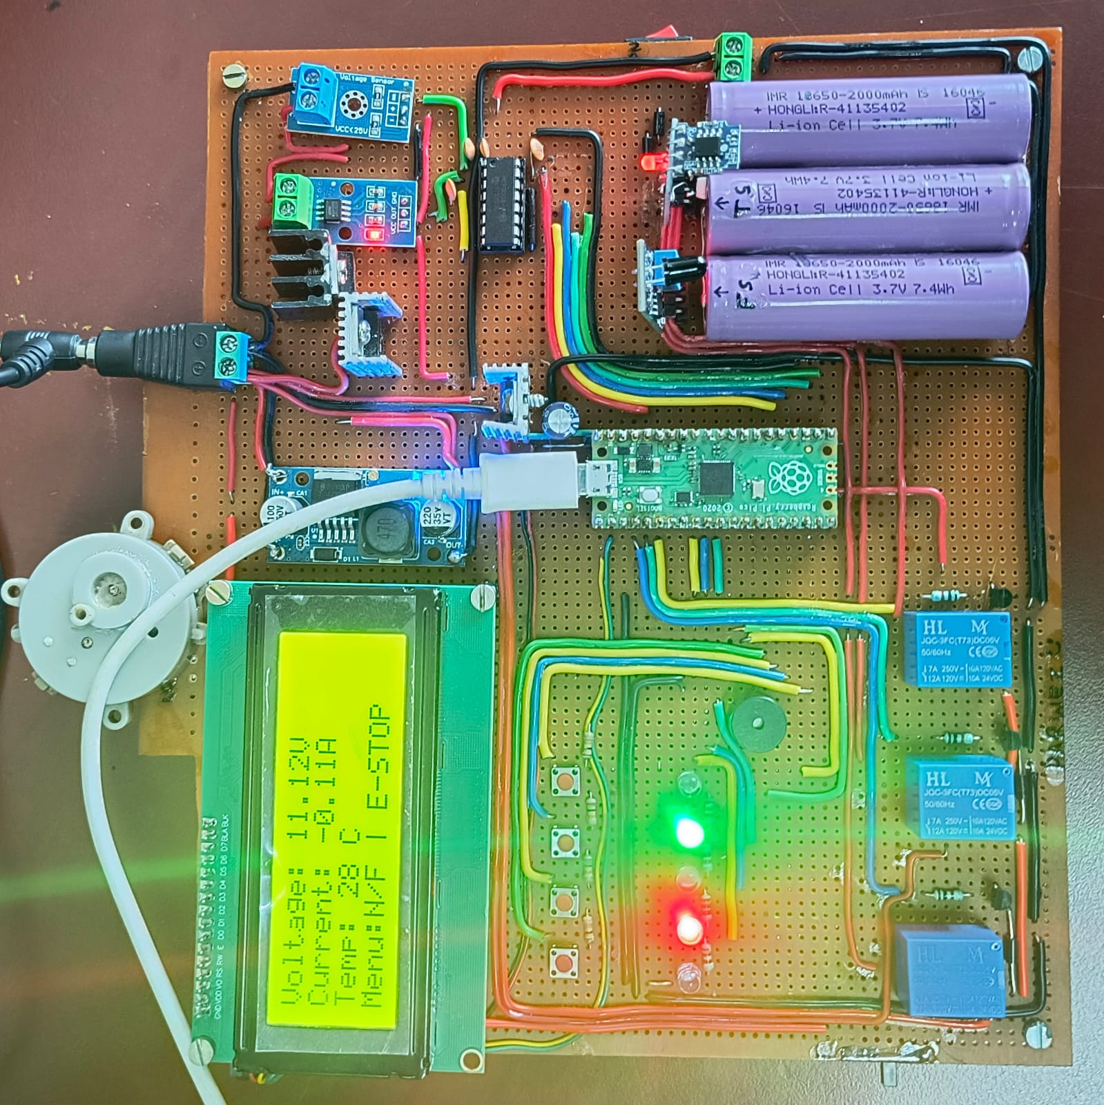
Hardware model

Slide 15
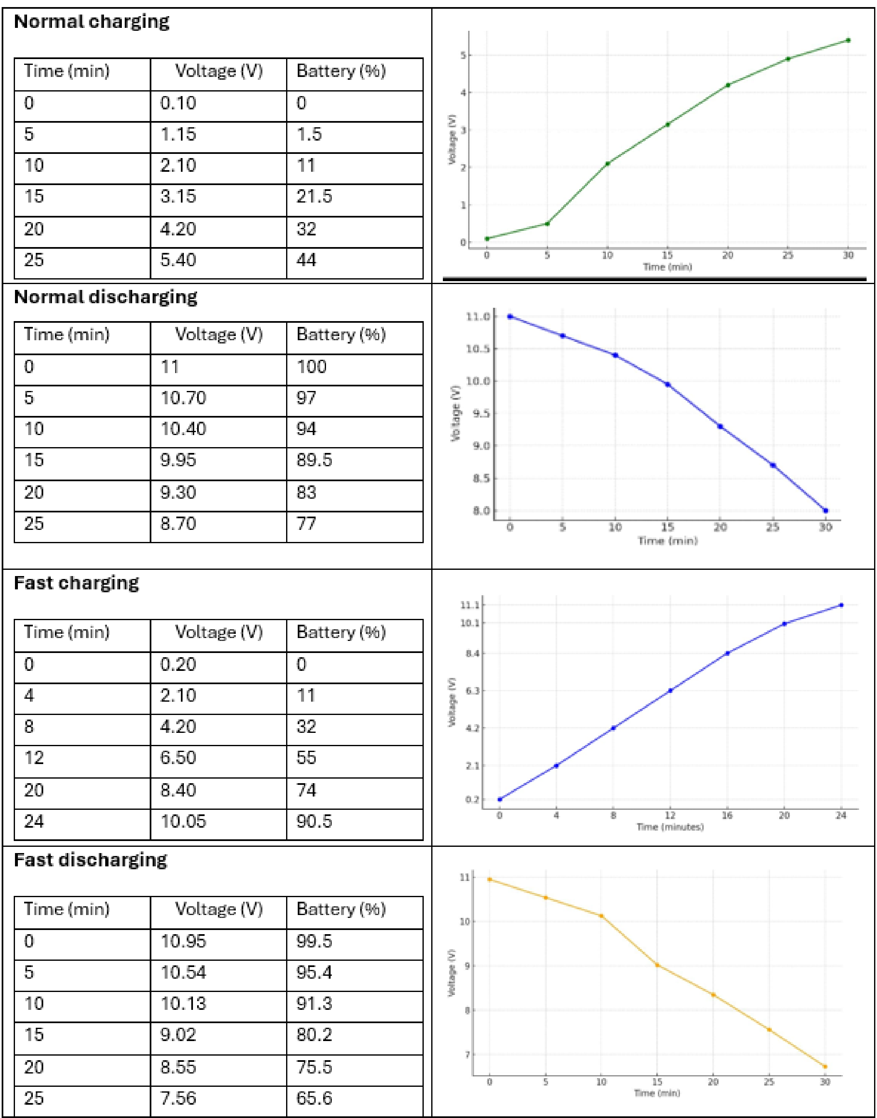
Observation Table

Slide 16
THANK YOU..

